Slide 1

21. Touch Grass
4. Multi-Agent Inventory Optimization & Supply Chain Coordination
Sanjay | Rithun | Sabari | Devan

Slide 2
The Problem
Current Supply Chain Challenges
  ERP & WMS systems generate static inventory plans
  Human planners is inefficient
    Manual demand forecasting is inaccurate
    React after stockouts or excess inventory
    Decisions are slow and inconsistent
  Multi-level complexity:
    Stores, warehouses, suppliers act independently
    No coordinated optimization
  Demand is:
    Stochastic
    Seasonal
    Influenced by promotions & delays

Slide 3
Hackathon Objectives
We aim to build a system with the following properties:
  HMARL system coordinating stores, warehouse, suppliers
  Predict demand under:
    Random fluctuations (Stochastic)
    Seasonal patterns
  Optimize inventory decisions to:
    Reduce stockouts
    Reduce overstocking
  Enable proactive, distributed decision-making
  Demonstrate measurable improvements via simulation
  Develop coordinated agents with dynamic inventory policies

Slide 4

Key Insight
Our Innovations
Reconciliation-Driven Learning
  Learn why plans failed, not just that they failed
  Structured feedback → better reward signals
Policy Overlay (Not Direct Control)
  RL adjusts parameters, not raw orders
  Safe, interpretable, ERP-compatible
Hierarchical Multi-Agent Design
  Mirrors real S&OP hierarchy:
    Global planning
    Local execution

Slide 5
Proposed Solution Overview
Digital Twin
Reconciliation Layer
Hierarchical Multi-Agent RL
Simulates demand, inventory, delays
Plan vs actual comparison
and Credit assignment
Global + local agents
Shadow Mode Deployment
Continuous Learning Loop
Observe before acting
Policies improve over time

Slide 6
Digital Twin Layer
Purpose
What it Simulates
State Variables
  Stores, warehouse, suppliers
  Inventory flows
  Order lead times
  Current stock levels
  Outstanding replenishment orders
  Daily demand per SKU
  Backorders / stockouts
  Safe environment to train and test policies
  No risk to real inventory
Demand Modeling
Outputs
  Base demand
  stochastic noise
  seasonal multiplier
  Fulfillment rates
  Plan vs actual deviations
  Stockouts

Slide 7



Reconciliation & Attribution Layer
Comparison
Planned inventory vs actual outcome for each SKU/store/warehouse
Attribute Deviation
  Demand spike → uncontrollable
  Supplier delay → supplier agent
  Poor allocation → warehouse agent
Why Reconcilation?
Classic RL struggles with:
  Sparse rewards
  Poor credit assignment
Reward Shaping
Penalize only controllable errors for faster, stable learning

Slide 8
Hierarchical Multi-Agent RL Layer
🔹 Global Coordinator Agent
🔹 Local Agents (Store / Warehouse)
  Operates at weekly / monthly level
  Adjusts:
    Safety stock multipliers
    Target service levels
    Optimizes system-wide KPIs
  Operate daily / hourly
  Adjust:
    Reorder points
    Allocation ratios
    Replenishment timing
Reward: deviations from target service & inventory, filtered by reconciliation

Slide 9
End-to-End Pipeline
Digital Twin
Reconciliation
HMARL Agents
Digital Twin simulates demand & operations
Reconciliation layer evaluates outcomes
HMARL agents update policy parameters
Shadow Mode
Metrics
Continuous Loop
Policies tested in Shadow Mode
Metrics logged
Loop repeats

Slide 10
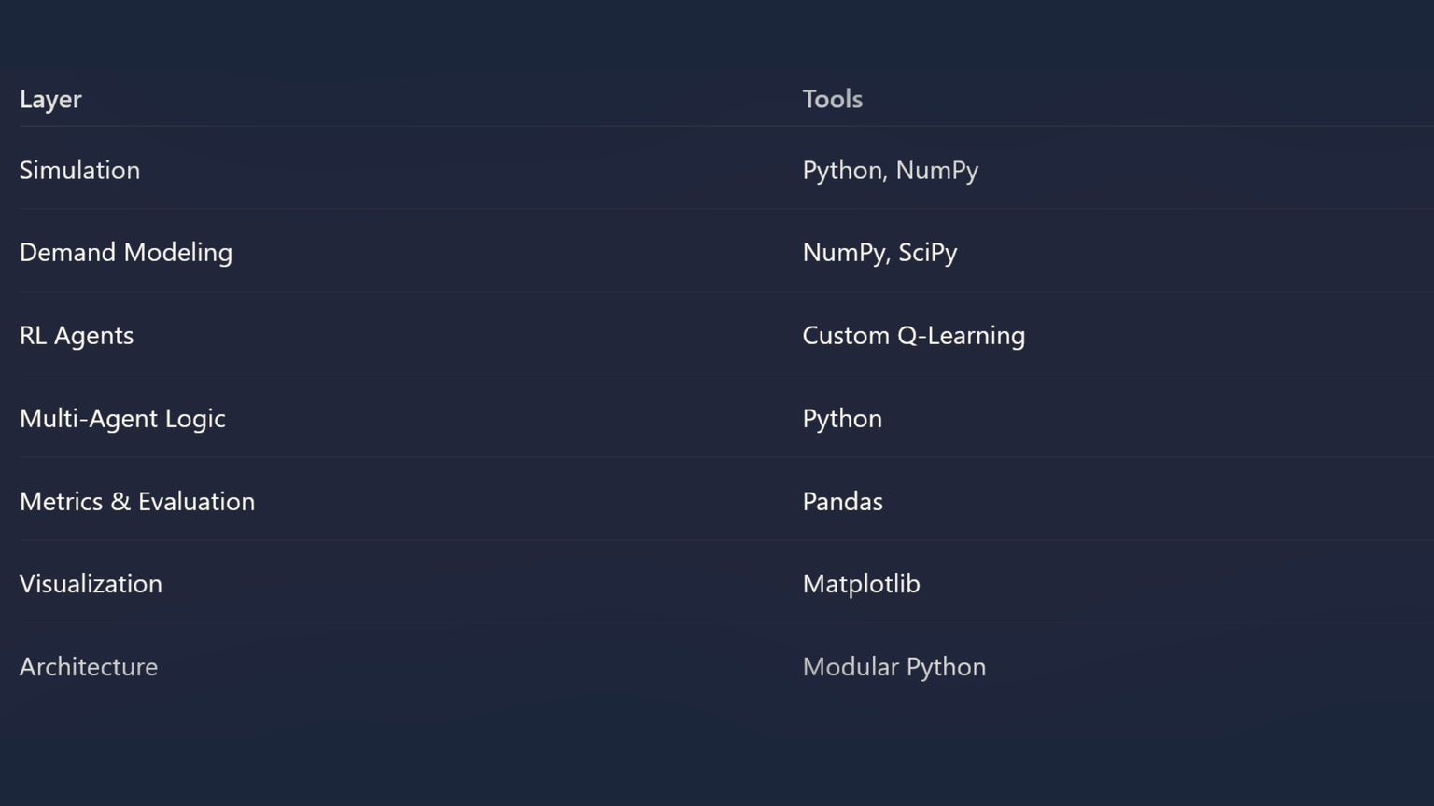
Tech Stack
Core Technologies

Slide 11
Expected Outcome
Dynamic inventory policies → adaptive safety stock & reorder points
Proactive, distributed decision-making across stores & warehouse
Measurable improvements in simulation:
Reduced stockouts
Lower excess inventory
Improved service level
Interpretable, safe policies for industrial adoption

Slide 12

Why Ours is Unique
Our system is not a black-box replacement for planners.
It is an adaptive policy overlay that learns from real operational outcomes using hierarchical multi-agent reinforcement learning.
By reconciling plans with reality and assigning responsibility correctly, it continuously improves inventory decisions under uncertainty - safely, interpretably and at scale.

